Slide 1
Surprising sentences
Vidhata Jayaraman

Slide 2
Motivation
Text analysis in low resource domains
  Not enough data for full model training
  Not enough resources to train
  Too time consuming to train a model
Environmental costs of training
Is there any way to bypass having to use a model at all?

Slide 3
Method Plan
Compare the different dimensionality reduction methods and compare this approach to modern LM approach
DATA
Find/Create a dataset of similar sentences
EMBEDDINGS
Calculate the embeddings of the sentences
DIMENSION REDUCTION
Dimensionally reduce the embeddings to something more manageable
Calculate surprisal values and rank sentences accordingly
COMPARE
SURPRISALS

Slide 4
Data/Embeddings
Data
Embeddings
Am currently using a dataset of yelp reviews where I subset the data set by certain keywords
- Ex. “pizza”, “staff”, “drink” …
Ways to represent semantic “meaning” of a word numerically
Used Hugging Face to calculate embeddings
Am currently using the “MiniLM-L6-v2” embedding

Slide 5
Dimensionality reduction
PCA, ICA, KPCA

Slide 6
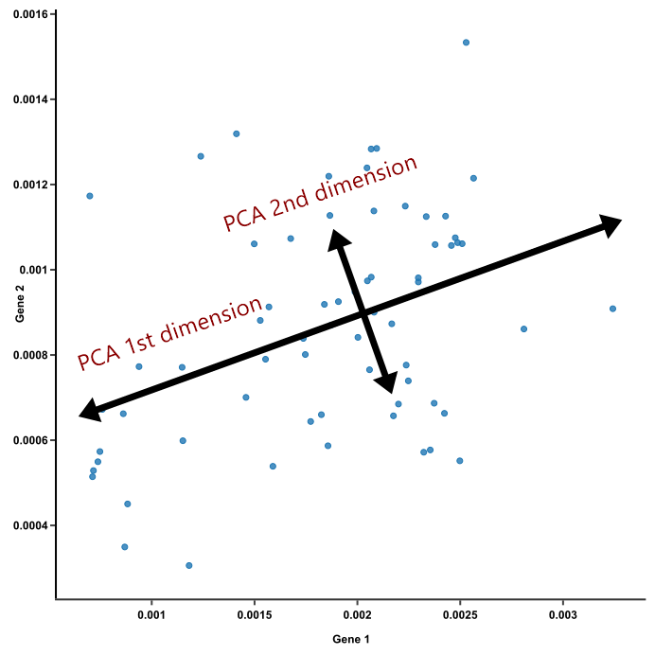
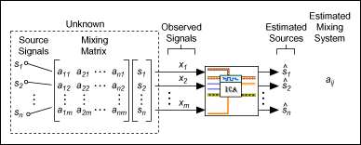
Dimensionality Reduction Methods
Standard and widely used dimensionality reduction technique and tries to preserve as much of the variance of the original data set as possible
Tries to identify independent components in a dataset. Typically used in signal processing to isolate signals but can also be used here to isolate independent components of a dataset
Kernel PCA: allows for the use of different non-linear kernels to allow for a non-linear dimensionality reduction unlike normal PCA
Kernels used here:
  Polynomial, Gaussian RBF, Sigmoid, Cosine
PCA
ICA
KPCA
https://blog.bioturing.com/2018/06/14/principal-component-analysis-explained-simply/
https://www.ni.com/docs/en-US/bundle/labview-advanced-signal-processing-toolkit-api-ref/page/lvasptconcepts/tsa_multivariate_stat_analysis.html

Slide 7
Probability & Surprisal
Histogram, bin numbers

Slide 8
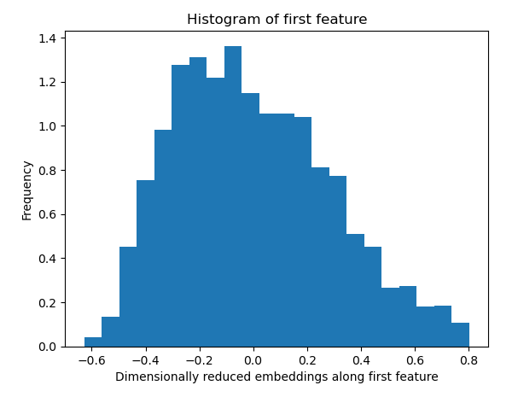
Histograms
Created histograms of each of the features of the dimensionally reduced embeddings
Used histogram to calculate probabilities of each feature in each sentence
Many different methods to determine # of bins
  Too few bins = over smoothing
  Too many = over fitting

Slide 9
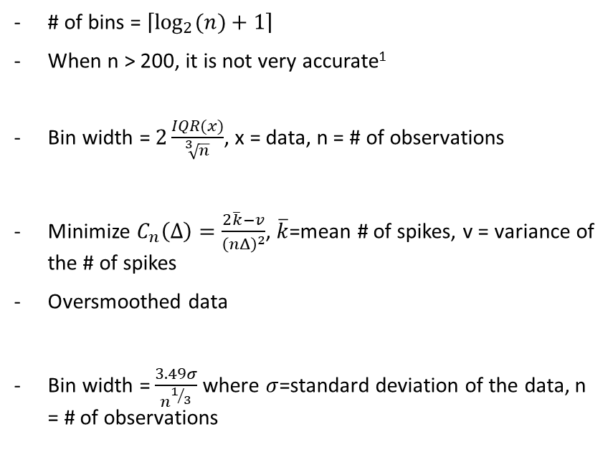
Bin methods analyzed
Method
Explanation
# of bins = $\left\lceil \log_{2}{(n)}+1\right\rceil$
When n > 200, it is not very accurate¹
Bin width = $2\frac{IQR(x)}{\sqrt[3]{n}}$, x = data, n = # of observations
Minimize $C_{n}\left(Δ\right)=\frac{2\overline{k}−v}{{\left(nΔ\right)}^{2}}$, $\overline{k}$=mean # of spikes, v = variance of the # of spikes
Oversmoothed data
Bin width = $\frac{3.49σ}{n^{1/3}}$ where $σ$=standard deviation of the data, n = # of observations
Sturges’ Rule
Freedman-Diaconis
Shimazaki²
Scott’s
Hyndman, Rob. (1995). The problem with Sturges’ rule for constructing histograms

Slide 10
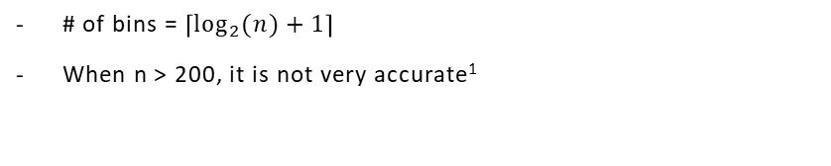
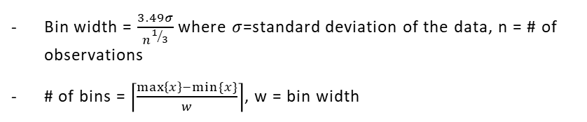
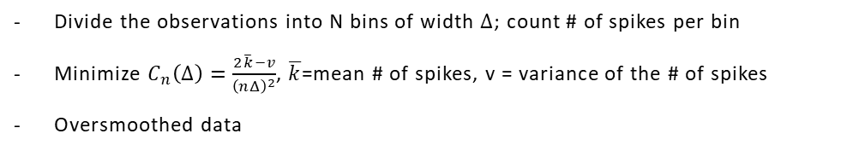
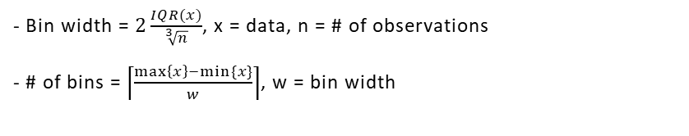
Bin methods analyzed
Sturges’ Rule
# of bins = $\left\lceil \log_{2}{(n)}+1\right\rceil$
When n > 200, it is not very accurate¹
Freedman-Diaconis
- Bin width = $2\frac{IQR(x)}{\sqrt[3]{n}}$, x = data, n = # of observations
- # of bins = $\left\lceil \frac{\max\left\{x\right\}−min⁡\{x\}}{w}\right\rceil$, w = bin width
Shimazaki²
Divide the observations into N bins of width $Δ$; count # of spikes per bin
Minimize $C_{n}\left(Δ\right)=\frac{2\overline{k}−v}{{\left(nΔ\right)}^{2}}$, $\overline{k}$=mean # of spikes, v = variance of the # of spikes
Oversmoothed data
Scott’s
Bin width = $\frac{3.49σ}{n^{1/3}}$ where $σ$=standard deviation of the data, n = # of observations
# of bins = $\left\lceil \frac{\max\left\{x\right\}−min⁡\{x\}}{w}\right\rceil$, w = bin width
Hyndman, Rob. (1995). The problem with Sturges’ rule for constructing histograms

Slide 11
Freedman-Diaconis vs Scott’s (compared to gpt-2)
Kendall Tau value
Notes:
Y axis: Kendall tau correlations (vs GPT-2 rankings)

Slide 12
Freedman-diaconis vs Scott’s (compared to gpt-2)
Freedman-Diaconis | Scott’s | Absolute Difference
0.135450272014585 | 0.133196120321646 | 0.002254152
0.281155022461135 | 0.280927347926228 | 0.000227675
-0.0496143653941658 | -0.0492824124463237 | 0.000331953
0.157877951676514 | 0.157943125684598 | 0.000065174
0.184037060547957 | 0.184067475085062 | 0.000030415
0.220371135561502 | 0.220816056790023 | 0.000444921

Slide 13
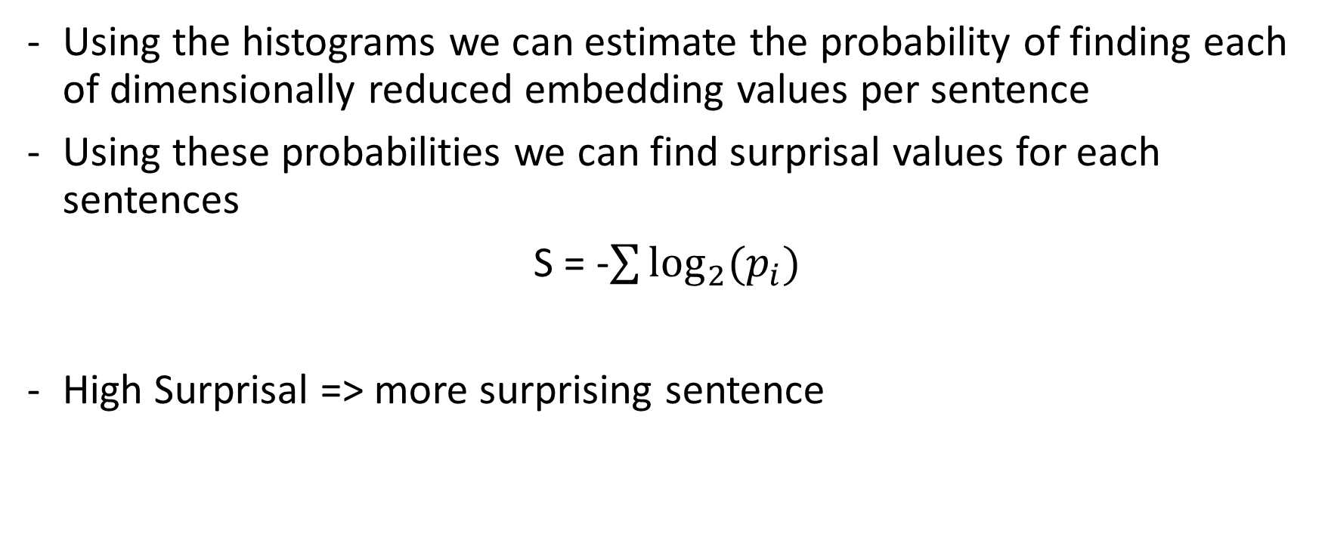
Surprisal
Using the histograms we can estimate the probability of finding each of dimensionally reduced embedding values per sentence
Using these probabilities we can find surprisal values for each sentences
S = -$\sum{\log_{2}{(p_{i})}}$
High Surprisal => more surprising sentence

Slide 14
Compare
TF-IDF, LLMs

Slide 15
Comparisons
Use different statistics to compare different dimensionality reduction methods with each other
Compare dimensionality reduction methods to other methods such as one involving Term Frequency-Inverse Document Frequency and the contemporary method with GPT-2

Slide 16
Compare
Compared each of the dimensionality reduction methods to each other
Compared each dimensionality reduction method to other approaches to this same problem

Slide 17
Other approaches
Large Language Models (LLMs)
Term Frequency-Inverse Document Frequency
(TF-IDF)
A way to measure how infrequently terms appear in a document
Sentences with many infrequent terms -> surprising
Train/fine-tune an LLM
Use generative capabilities of LLMs to determine probability of subsequent terms given previous terms
Use this probability to calculate a surprisal value
LLM’s used here are GPT-2 and LLaMA

Slide 18
Results

Slide 19
Cosine KPCA is worst performing among all methods
Normalized Sentence Ranking

Slide 20
TF-IDF and PCA are the fastest models
(GPT-2 took 5280 seconds)
Timing (s)

Slide 21
Larger datasets have larger minimum components required & ICA has lowest required components on average
# of components

Slide 22
TF-IDF and ICA have the most similar rankings to GPT-2 on average
Kendall Tau value

